Slide 1


MAVEN GOALS &
LIFECYCLE
BY DIYA KORANGA
& KARAN NAYAL

Slide 2

GOALS OF MAVEN
The goal of Maven is to manage a project’s build infrastructure. It is a software project management tool that uses a declarative XML file (POM) to handle the project’s build, dependency management, and documentation. Maven uses the concept of a “build lifecycle” to manage the different stages of a project’s build.

Slide 3
ADVANTAGES
Simplified Build.
Dependency Management.
Convention over Configuration.
Centralized Repository.
Clear Build Lifecycle.

Slide 4


MAVEN LIFE CYCLE
Maven defines 3 build lifecycles
Default Lifecycle
Clean Lifecycle
Site Lifecycle
Each and every phase in lifecycle has a unique goal,
followings are the goals/tasks performed by lifecycle phases:
Resource Preparation- copies resources like configuration files to build folder.
Compilation- Compiling source codes.
Packaging- Copying dependency JAR files to build folder.
Runs unit tests.

Slide 5

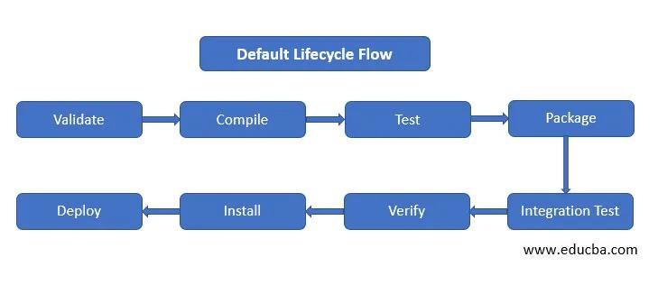
1. DEFAULT LIFECYCLE

Slide 6
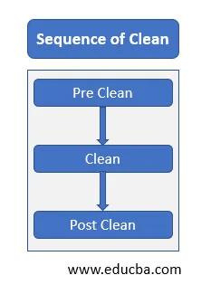

2. Clean Lifecycle

Slide 7
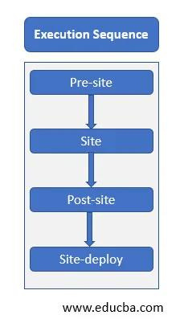
3. SITE LIFECYCLE

Slide 8


CONCLUSION
Maven has three key lifecycles: Clean, Default, and Site.
Clean Lifecycle: Clears old project files for a fresh start.
Default Lifecycle: Handles core build tasks like compiling and testing.
Site Lifecycle:Generates project documentation and creates a website.
Together, these lifecycles streamline and organize the software development process in Maven.

Slide 9

THANK YOU

